Slide 1


DIGITAL MALL
PREPARED BY : -
NAME : - DHIRAJ PATIL
DIVISION : - D2
ROLL NO : - 51
BRANCH : - CE

Slide 2
PROJECT OUTLINE
Introduction
Digital Items
Payment Method
Flow Chart

Slide 3

Introduction to DIGITAL MALL
A Digital Mall is a Software designed to buy digital items . It include functionalities like buy digital items, payment for digital items.

Slide 4
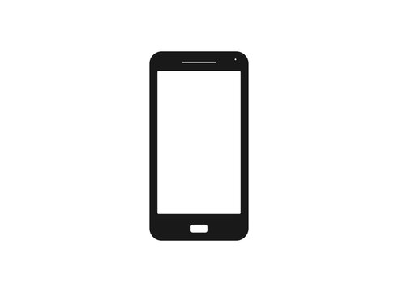
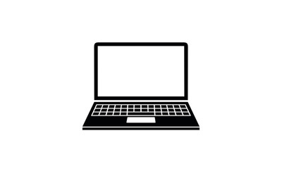

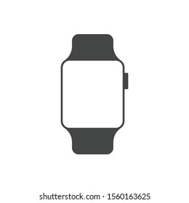
DIGITAL ITEMS
MOBILE
LAPTOP
TELIVISION
SMART WATCH

Slide 5
Payment Method
Cash Payment
Debit Card
Net Banking

Slide 6
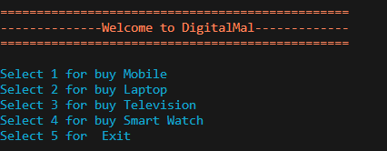
FLOWCHART
True
If
Choice !=5
False
Buy Products And
Payment
END

Slide 7
THANK YOU

